Slide 1

Data Engineering Behind Stock Analysis
Debdas Ghosh and Connor Wilson

Slide 2
Project Goals
Enable data-driven decision making for stock trades
Analyze trends for S&P 500 companies

Slide 3



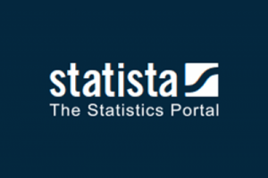
Data Set(s)
DAILY STOCK TRADES (JAN. 2017~APRIL 2021)
COMPANY INFORMATION
MARKET SENTIMENTS
(PER COMPANY)
QUARTERLY REVENUES
Notes:
Only companies based in the US
Limited set of “twits” due to API limitations

Slide 4
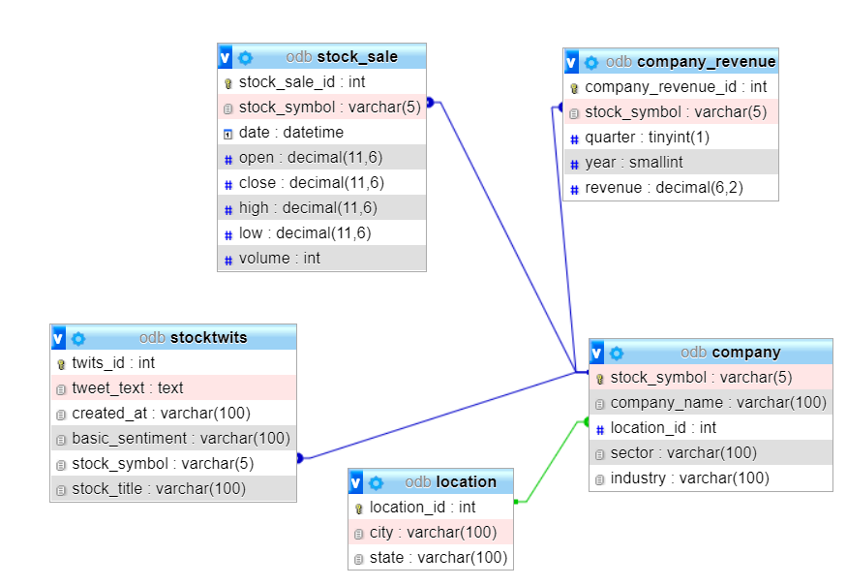
Operational Database

Slide 5
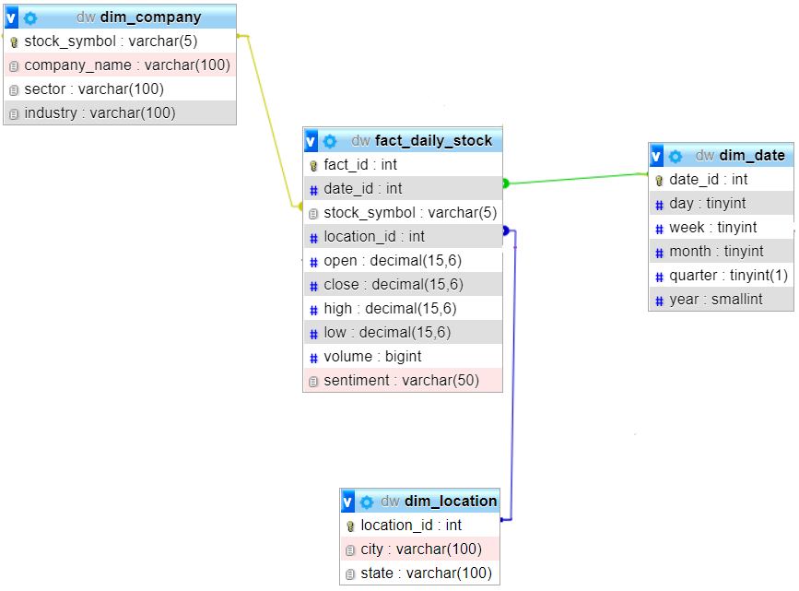
STAR SCHEMA

Slide 6
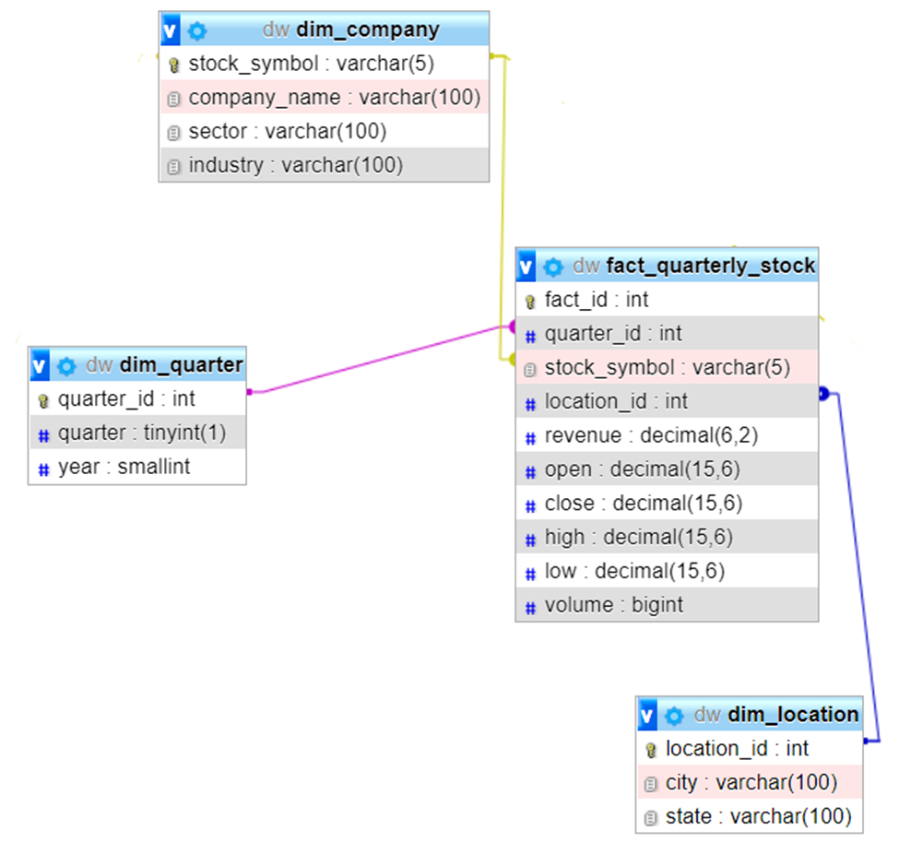
STAR SCHEMA

Slide 7
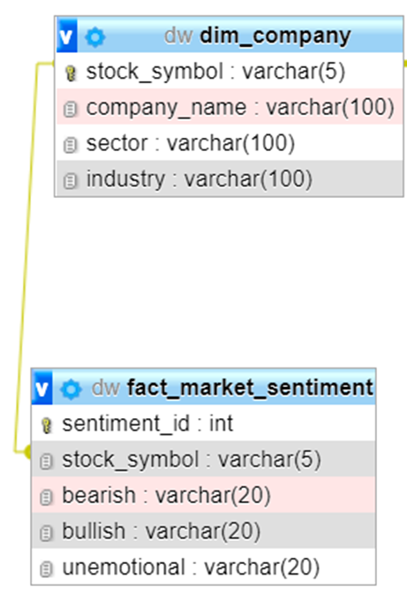
STAR SCHEMA

Slide 8
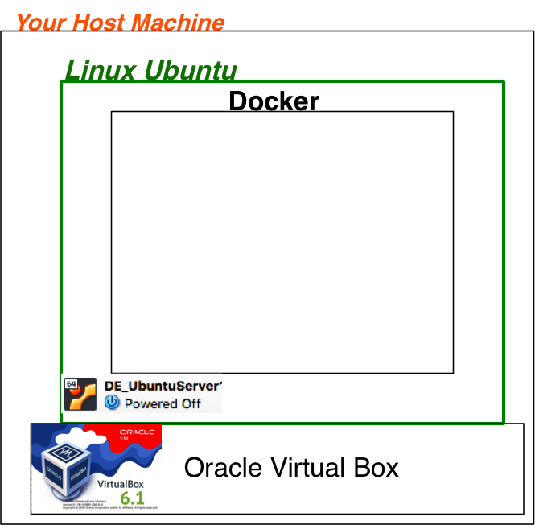
ODB Client
DW Client
Admin
Client
Admin
Client
Web
Server
Designing Environment
ODB
DW
MySQL
Server
MySQL
Server
Twits
Kafka Broker
AggrData
Data
Data
ZooKeeper
8

Slide 9
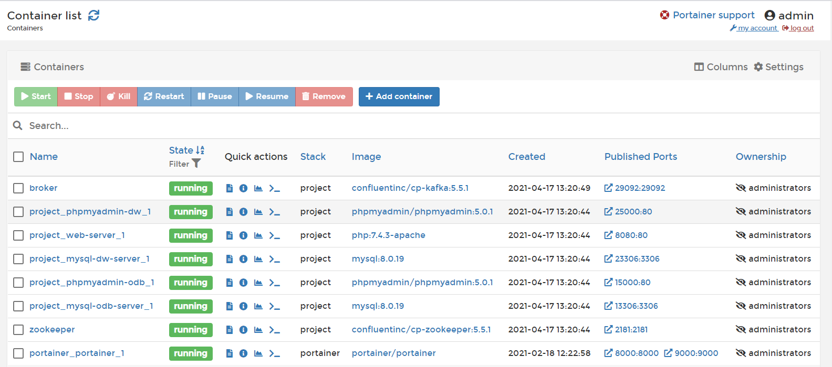
Containers

Slide 10
Bullish : Apple has yet to fail me when I need her. I doubt this week will be anything short of spectacular. Bearish : tech bros are playing a very risky game with the exception of $AAPL $QCOM No Sentiment : The is actual footage of Bears waking up tomorrow & going down stairs to answer Margin Calls $AAPL $TSLA
Tweets

Slide 11
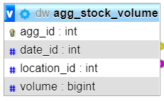
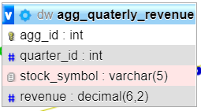
Summary Tables
Which state has the highest volume of stock trades on a particular day?
SELECT dl.state, sum(rc.volume) AS tot_vol
from agg_stock_volume rc
INNER JOIN dim_location dl on dl.location_id=rc.location_id
INNER JOIN dim_date d on d.date_id = rc.date_id
WHERE d.year = 2017 and d.month = 1 and d.day = 3
GROUP BY dl.state ORDER BY tot_vol DESC;
Revenues per sector in a particular quarter
SELECT sc.sector, sum(rc.revenue) AS revenue
from dim_company sc
INNER JOIN agg_quaterly_revenue rc on rc.stock_symbol=sc.stock_symbol
INNER JOIN dim_quarter q on q.quarter_id = rc.quarter_id
WHERE q.year = 2017 and q.quarter = 3
GROUP BY sc.sector ORDER BY revenue DESC;

Slide 12
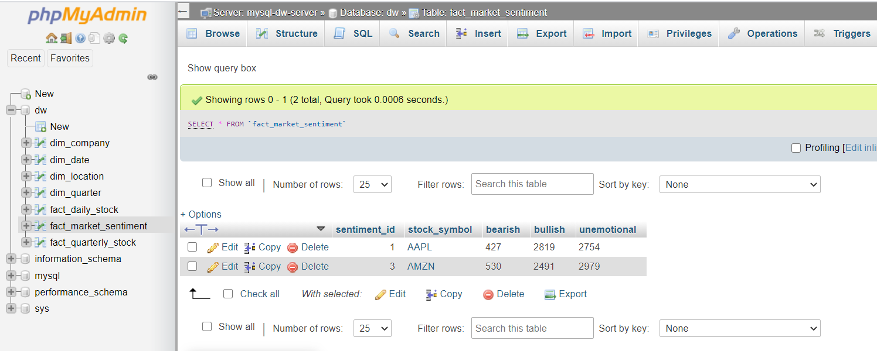
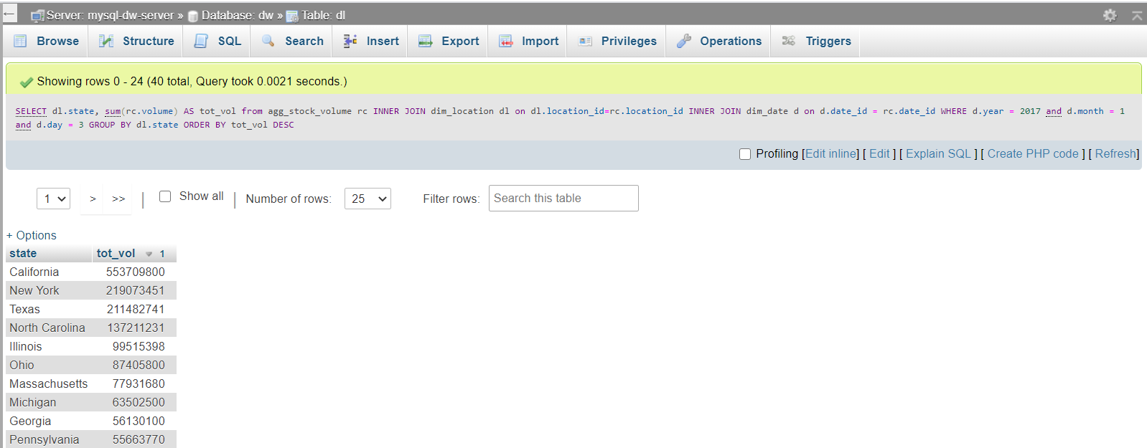
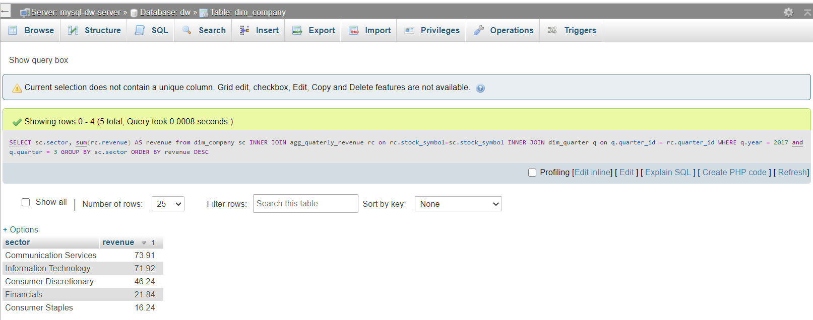
Results

Slide 13
How market sentiments affects Stock performance?
Future Scope

Slide 14
Thank You

